Slide 1
Should Wizard Hit Mommy
John Hoyer Updike

Slide 2
About the Author
John Hoyer Updike (March 18, 1932 – January 27, 2009) was an American novelist, poet, short-story writer, art critic, and literary critic. One of only three writers to win the Pulitzer Prize for Fiction more than once. Updike published more than twenty novels, more than a dozen short-story collections, as well as poetry, art and literary criticism and children's books during his career.

Slide 3
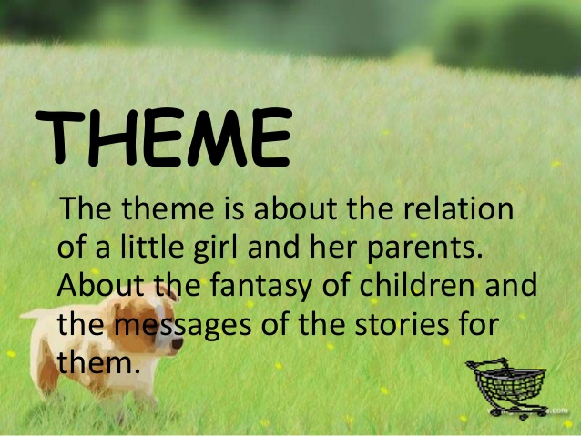

Slide 4
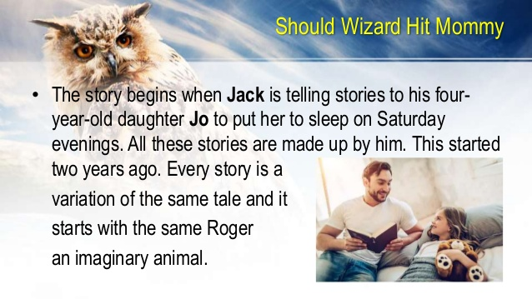

Slide 5
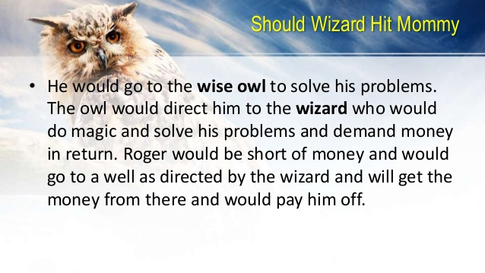

Slide 6
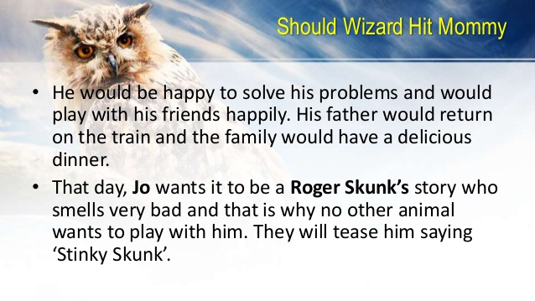

Slide 7
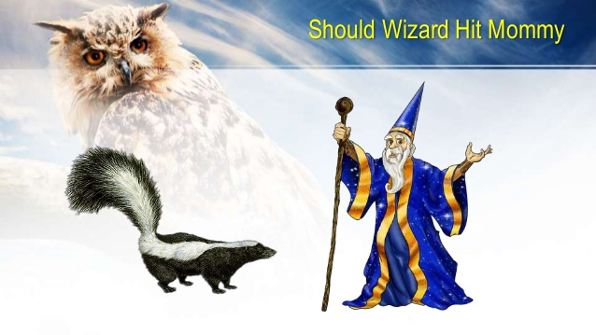

Slide 8
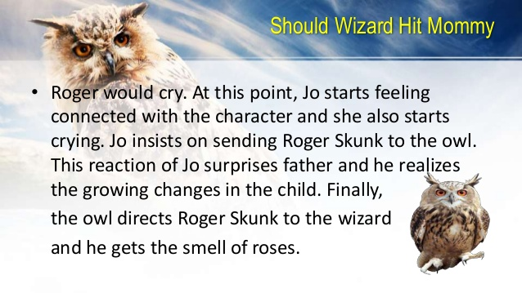

Slide 9
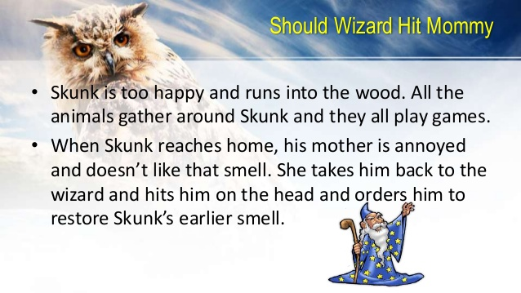

Slide 10
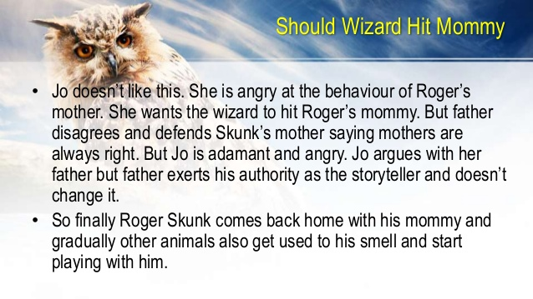

Slide 11
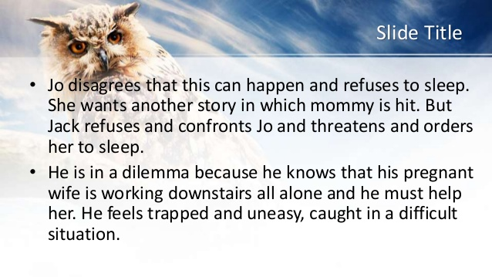

Slide 12
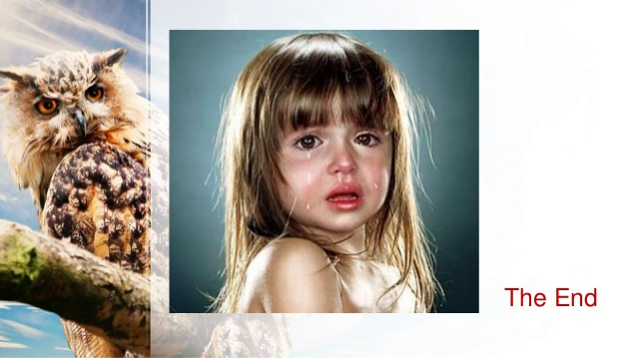

Slide 13
Vocabulary
Nap- a short sleep, especially during the day.
Wizard- a man who has magical powers.
Magic Spell- a form of words used as a magical charm .
Pennies- a small sum of money.
Fatiguing- cause (someone) to feel exhausted.
Rite- a social custom, practice, or conventional act.
Futile- pointless.
Skunk- A small cat sized animal.
Stirred- move or cause to move slightly.
Woodland- land covered with trees.
Solemnly- with deep sincerity.
Zest- great enthusiasm and energy.
Humiliation- make (someone) feel ashamed and foolish by injuring their dignity and pride.
Stinky- having a strong or unpleasant smell.

Slide 14
Scraped- drag or pull a hard or sharp implement
Enormous- very large in size
Eager- keenly expectant or interested..
Narrative- a story.
Swamp- an area of low-lying, uncultivated ground where water collects; a bog or marsh.
Crick- A small river.
Rapped- strike (a hard surface) with a series of rapid audible blows, especially in order to attract attention.
Relapsed- return to a less active or a worse state.
Curtly- rudely brief in speech or abrupt in manner
Sill- a shelf or slab of stone, wood, or metal at the foot of a window opening or doorway.
Clenched- closed into a tight ball.
Infantile- childish.
Scrunching- make a loud crunching noise.
Whining- the making of a long, high-pitched cry or sound.
Rheumy- watery
Rummaged- search unsystematically and untidily through something.
Smugly- in a way that shows excessive satisfaction or pride in oneself.
Trance- a half-conscious state

Slide 15
Rapt- completely fascinated or absorbed by what one is seeing or hearing.
Cranky- bad-tempered; irritable.
Rumbled- make a continuous deep sound.
Fuss- to show excessive excitement
Apprehensive- fearful that something bad or unpleasant will happen.
Awful- very bad or unpleasant.
Skittered- move lightly and quickly
Underbrush- shrubs and small trees
Astounded- shock or greatly surprise.
Lima Beans- an edible flat whitish bean.
Celery- a cultivated plant of the parsley family
Tiptoed- walk quietly
Pretense- an attempt to make something that is false, to appear true.
Gingerly- in a careful or cautious manner.
Heave- produce a sigh.
Stroking- move one's hand with gentle pressure
Spank- slap with one's open hand
Weariness- extreme tiredness

